Slide 1
Hashing

Slide 2
Direct Addressing
Assumptions:
  Key values are distinct
  Each key is drawn from a universe U = {0, 1, . . . , n - 1}
Idea:
  Store the items in an array, indexed by keys

Slide 3
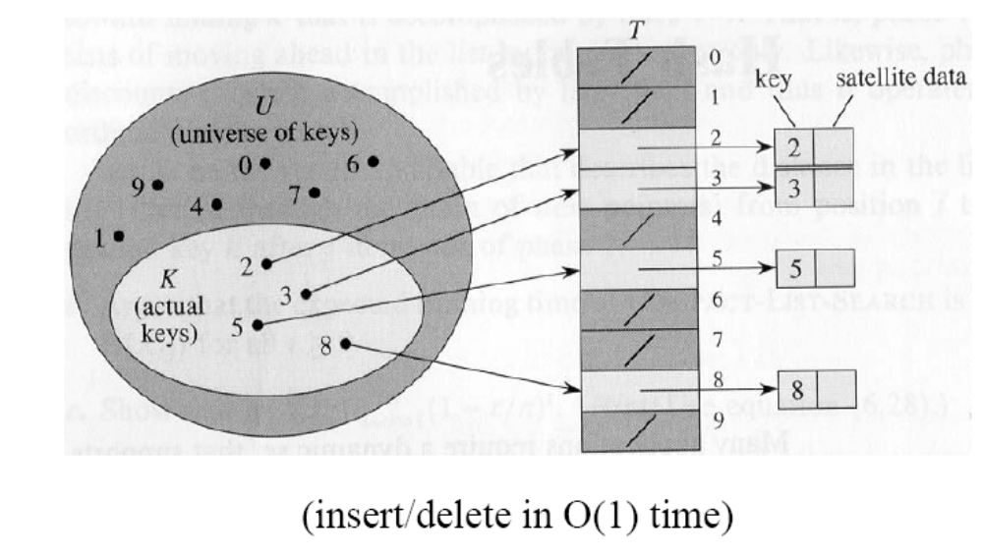
Direct Addressing (cont’d)
Direct-address table representation:
  An array T[0 . . . n - 1]
  Each slot, or position, in T corresponds to a key in U
  For an element x with key k, a pointer to x will be placed in location T[k]
  If there are no elements with key k in the set, T[k] is empty, represented by NIL
Search, insert, delete in O(1) time!

Slide 4
Direct Addressing (cont’d)
Example 1: Suppose that the are integers from 1 to 100 and
that there are about 100 records.
Create an array A of 100 items and stored the record whose key
is equal to i in in A[i].
|K| = |U|
|K|: # elements in K
|U|: # elements in U

Slide 5
Direct Addressing (cont’d)
Example 2: Suppose that the keys are 9-digit social security
numbers (SSN)
Although we could use the same idea, it would be very inefficient
(i.e., use an array of 1 billion size to store 100 records)
|K| << |U|

Slide 6
Hashing
Idea:
  Use a function h to compute the slot for each key
  Store the element in slot h(k)
A hash function h transforms a key into an index in a hash table T[0…m-1]:
h : U → {0, 1, . . . , m - 1}
We say that k hashes to slot h(k)

Slide 7
Hashing (cont’d)
0
U
(universe of keys)
h(k₁)
h(k₄)
k₁
K
(actual
keys)
k₄
k₂
h(k₂) = h(k₅)
k₅
k₃
h(k₃)
m - 1
h : U → {0, 1, . . . , m - 1}
hash table size: m

Slide 8
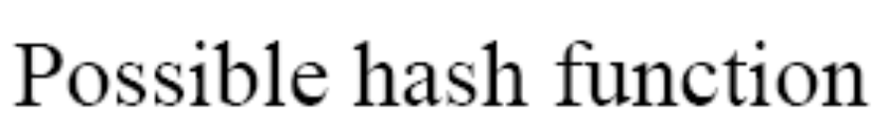
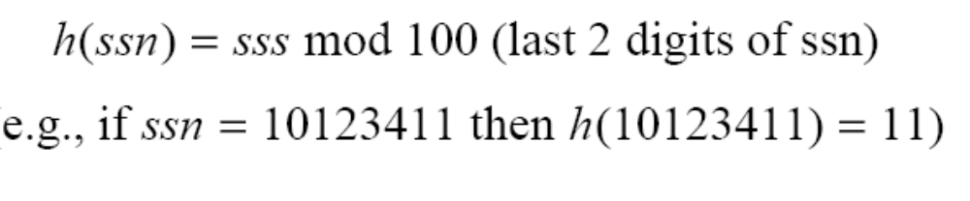
Hashing (cont’d)
Example 2: Suppose that the keys are 9-digit social security
numbers (SSN)

Slide 9
Advantages of Hashing
Reduce the range of array indices handled:
m instead of |U|
where m is the hash table size: T[0, …, m-1]
Storage is reduced.
O(1) search time (i.e., under assumptions).

Slide 10
Collisions
Collisions occur when h(k_{i})=h(k_{j}), i≠j
0
U
(universe of keys)
h(k₁)
h(k₄)
K
(actual
keys)
k₁
k₄
k₂
h(k₂) = h(k₅)
k₅
k₃
h(k₃)
m - 1

Slide 11
Collisions (cont’d)
For a given set K of keys:
  If |K| ≤ m, collisions may or may not happen, depending on the hash function!
  If |K| > m, collisions will definitely happen (i.e., there must be at least two keys that have the same hash value)
Avoiding collisions completely might not be easy.

Slide 12
Handling Collisions
We will discuss two main methods:
  (1) Chaining
  (2) Open addressing
    Linear probing
    Quadratic probing
    Double hashing

Slide 13
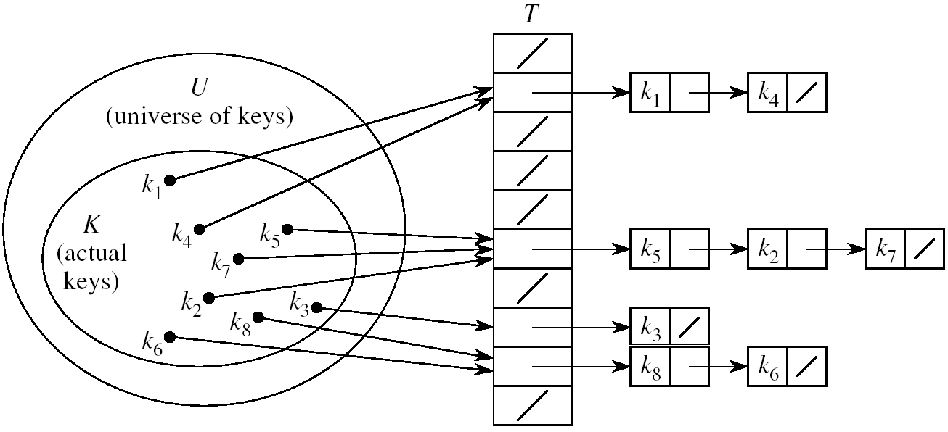
Chaining
Idea:
  Put all elements that hash to the same slot into a linked list
  Slot j contains a pointer to the head of the list of all elements that hash to j

Slide 14
Chaining (cont’d)
How to choose the size of the hash table m?
  Small enough to avoid wasting space.
  Large enough to avoid many collisions and keep linked-lists short.
  Typically 1/5 or 1/10 of the total number of elements.
Should we use sorted or unsorted linked lists?
  Unsorted
    Insert is fast
    Can easily remove the most recently inserted elements

Slide 15
Hash Table Operations
Search
Insert
Delete

Slide 16
Searching in Hash Tables
Alg.: CHAINED-HASH-SEARCH(T, k)
search for an element with key k in list T[h(k)]
Running time depends on the length of the list of elements in slot h(k)

Slide 17
Insertion in Hash Tables
Alg.: CHAINED-HASH-INSERT(T, x)
insert x at the head of list T[h(key[x])]
T[h(key[x])] takes O(1) time; insert will take O(1) time overall since lists are unsorted.
Note: if no duplicates are allowed, It would take extra time to check if item was already inserted.

Slide 18
Deletion in Hash Tables
Alg.: CHAINED-HASH-DELETE(T, x)
delete x from the list T[h(key[x])]
T[h(key[x])] takes O(1) time.
Finding the item depends on the length of the list of elements in slot h(key[x])

Slide 19
Analysis of Hashing with Chaining:
Worst Case
How long does it take to search for an element with a given key?
Worst case:
  All n keys hash to the same slot
then O(n) plus time to compute the hash function
T
0
chain
m - 1

Slide 20
Analysis of Hashing with Chaining:
Average Case
It depends on how well the hash function distributes the n keys among the m slots
Under the following assumptions:
  (1) n = O(m)
  (2) any given element is equally likely to hash into any of the m slots (i.e., simple uniform hashing property)
then → O(1) time plus time to compute the hash function
T
n₀ = 0
n₂
n₃
n_{j}
n_{k}
n_{m – 1} = 0

Slide 21
Properties of Good Hash Functions
Good hash function properties
  Easy to compute
  (2) Approximates a random function
  i.e., for every input, every output is equally likely.
  (3) Minimizes the chance that similar keys hash to the same slot
  i.e., strings such as pt and pts should hash to different slot.
We will discuss two methods:
  Division method
  Multiplication method

Slide 22
The Division Method
Idea:
  Map a key k into one of the m slots by taking the remainder of k divided by m
  h(k) = k mod m
Advantage:
  fast, requires only one operation
Disadvantage:
  Certain values of m are bad (i.e., collisions), e.g.,
    power of 2
    non-prime numbers

Slide 23
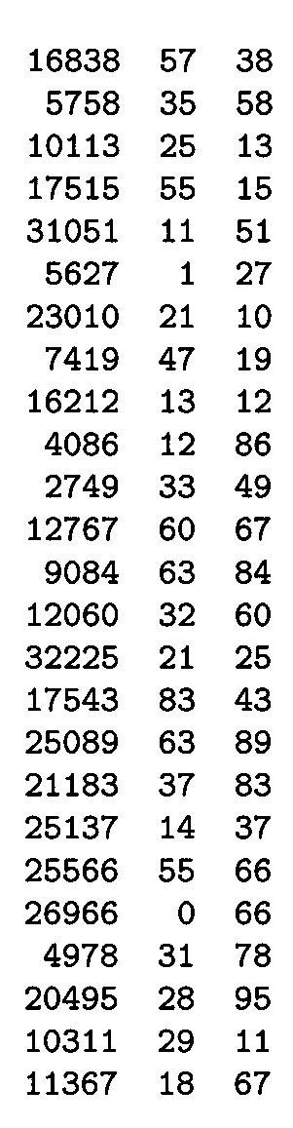
Example
m97
m
100
If m = 2^{p}, then h(k) is just the least significant p bits of k
  p = 1 ⇒ m = 2
  ⇒ h(k) = , least significant 1 bit of k
  p = 2 ⇒ m = 4
  ⇒ h(k) = , least significant 2 bits of k
Choose m to be a prime, not close to a
power of 2
  Column 2:
  Column 3:
{0, 1}
{0, 1, 2, 3}
k mod 97
k mod 100

Slide 24

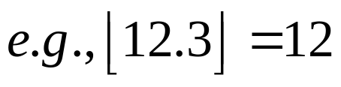
The Multiplication Method
Idea:
(1) Multiply key k by a constant A, where 0 < A < 1
(2) Extract the fractional part of kA
(3) Multiply the fractional part by m
(4) Truncate the result
h(k) = = ⎣m (k A mod 1)⎦
Disadvantage: Slower than division method
Advantage: Value of m is not critical
fractional part of kA = kA - ⎣kA⎦

Slide 25
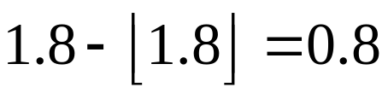
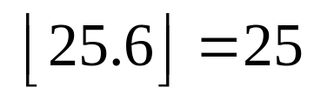
Example – Multiplication Method
Suppose k=6, A=0.3, m=32
(1) k x A = 1.8
(2) fractional part:
(3) m x 0.8 = 32 x 0.8 = 25.6
(4)
h(6)=25

Slide 26
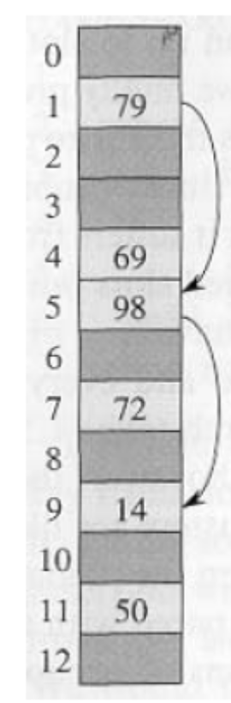
Open Addressing
Idea: store the keys in the table itself
No need to use linked lists anymore
Basic idea:
  Insertion: if a slot is full, try another one,
  until you find an empty one.
  Search: follow the same probe sequence.
  Deletion: need to be careful!
Search time depends on the length of
probe sequences!
e.g., insert 14
probe sequence:
<1, 5, 9>

Slide 27
Generalize hash function notation:
A hash function contains two arguments now:
  (i) key value, and (ii) probe number
  h(k,p), p=0,1,...,m-1
Probe sequence:
<h(k,0), h(k,1), h(k,2), …. >
Example:
e.g., insert 14
Probe sequence:
<h(14,0), h(14,1), h(14,2)>=<1, 5, 9>

Slide 28
Generalize hash function notation:
  Probe sequence must be a permutation of
  <0,1,...,m-1>
  There are m! possible permutations
e.g., insert 14
Probe sequence:
<h(14,0), h(14,1), h(14,2)>=<1, 5, 9>

Slide 29
Common Open Addressing Methods
Linear probing
Quadratic probing
Double hashing
None of these methods can generate more than m² different probe sequences!

Slide 30
Linear probing: Inserting a key
Idea: when there is a collision, check the next available position in the table:
h(k,i) = (h₁(k) + i) mod m
i=0,1,2,...
i=0: first slot probed: h₁(k)
i=1: second slot probed: h₁(k) + 1
i=2: third slot probed: h₁(k)+2, and so on
How many probe sequences can linear probing generate?
m probe sequences maximum
probe sequence: < h₁(k), h₁(k)+1 , h₁(k)+2 , ....>
wrap around

Slide 31
Linear probing: Searching for a key
Given a key, generate a probe sequence using the same procedure.
Three cases:
  (1) Position in table is occupied with an element of equal key→ FOUND
  (2) Position in table occupied with a
  different element → KEEP SEARCHING
  (3) Position in table is empty→ NOT FOUND
0
m - 1
wrap around

Slide 32
Linear probing: Searching for a key
Running time depends on the length of
the probe sequences.
Need to keep probe sequences
short to ensure fast search.
0
m - 1
wrap around

Slide 33
Linear probing: Deleting a key
First, find the slot containing the key
to be deleted.
Can we just mark the slot as empty?
  It would be impossible to retrieve keys inserted after that slot was occupied!
Solution
  “Mark” the slot with a sentinel value DELETED
The deleted slot can later be used for insertion.
e.g., delete 98
0
m - 1

Slide 34
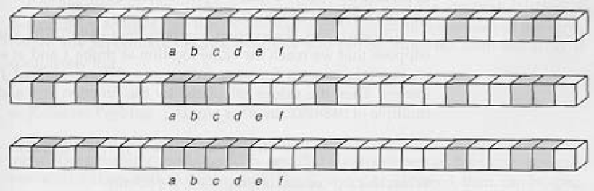
Primary Clustering Problem
Long chunks of occupied slots are created.
As a result, some slots become more likely than others.
Probe sequences increase in length. ⇒ search time increases!!
initially, all slots have probability 1/m
Slot b:
2/m
Slot d:
4/m
Slot e:
5/m

Slide 35
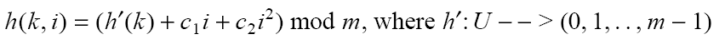
Quadratic probing
i=0,1,2,...
Clustering is less serious but still a problem (secondary
clustering)
How many probe sequences can quadratic probing
generate?
m -- the initial position determines probe sequence

Slide 36
Double Hashing
(1) Use one hash function to determine the first slot.
(2) Use a second hash function to determine the increment for the probe sequence:
h(k,i) = (h₁(k) + i h₂(k) ) mod m, i=0,1,...
Initial probe: h₁(k)
Second probe is offset by h₂(k) mod m, so on ...
Advantage: handles clustering better
Disadvantage: more time consuming
How many probe sequences can double hashing generate?
m² -- why?

Slide 37
Double Hashing: Example
h₁(k) = k mod 13
h₂(k) = 1+ (k mod 11)
h(k,i) = (h₁(k) + i h₂(k) ) mod 13
Insert key 14:
i=0: h(14,0) = h₁(14) = 14 mod 13 = 1
i=1: h(14,1) = (h₁(14) + h₂(14)) mod 13
= (1 + 4) mod 13 = 5
i=2: h(14,2) = (h₁(14) + 2 h₂(14)) mod 13
= (1 + 8) mod 13 = 9
0
79
69
98
72
50
1
2
3
4
5
6
7
8
9
14
10
11
12

